Slide 1
Smart Billboard Advertising Ecosystem
INFO 5100 – Application Engineering & Development
Technology used
Java Swing UI
DB40 Persistence
Object-Oriented Design
UML & Enterprise Modeling
Project By:
Preksha Praveen
Manav Shah
Hiteshi Kawadia
Jayashree Muniyappa

Slide 2
Problem Statement
Current Industry Challenges
Billboard advertising involves multiple independent stakeholders
Manual coordination between:
  Advertising Agencies
  Billboard Operators
  City Authorities
  Power Utilities
Leads to delays, errors, and poor visibility
Objective
Design a centralized, role-based system that enables structured coordination between independent enterprises.

Slide 3
High-Level Ecosystem Design
Core Architecture
EcoSystem
Network
Enterprise
Organization
UserAccount & Role
Implemented Enterprises
SkyViewBillboardEnterprise
AdAgencyEnterprise
CityServicesEnterprise
PowerUtilityEnterprise

Slide 4
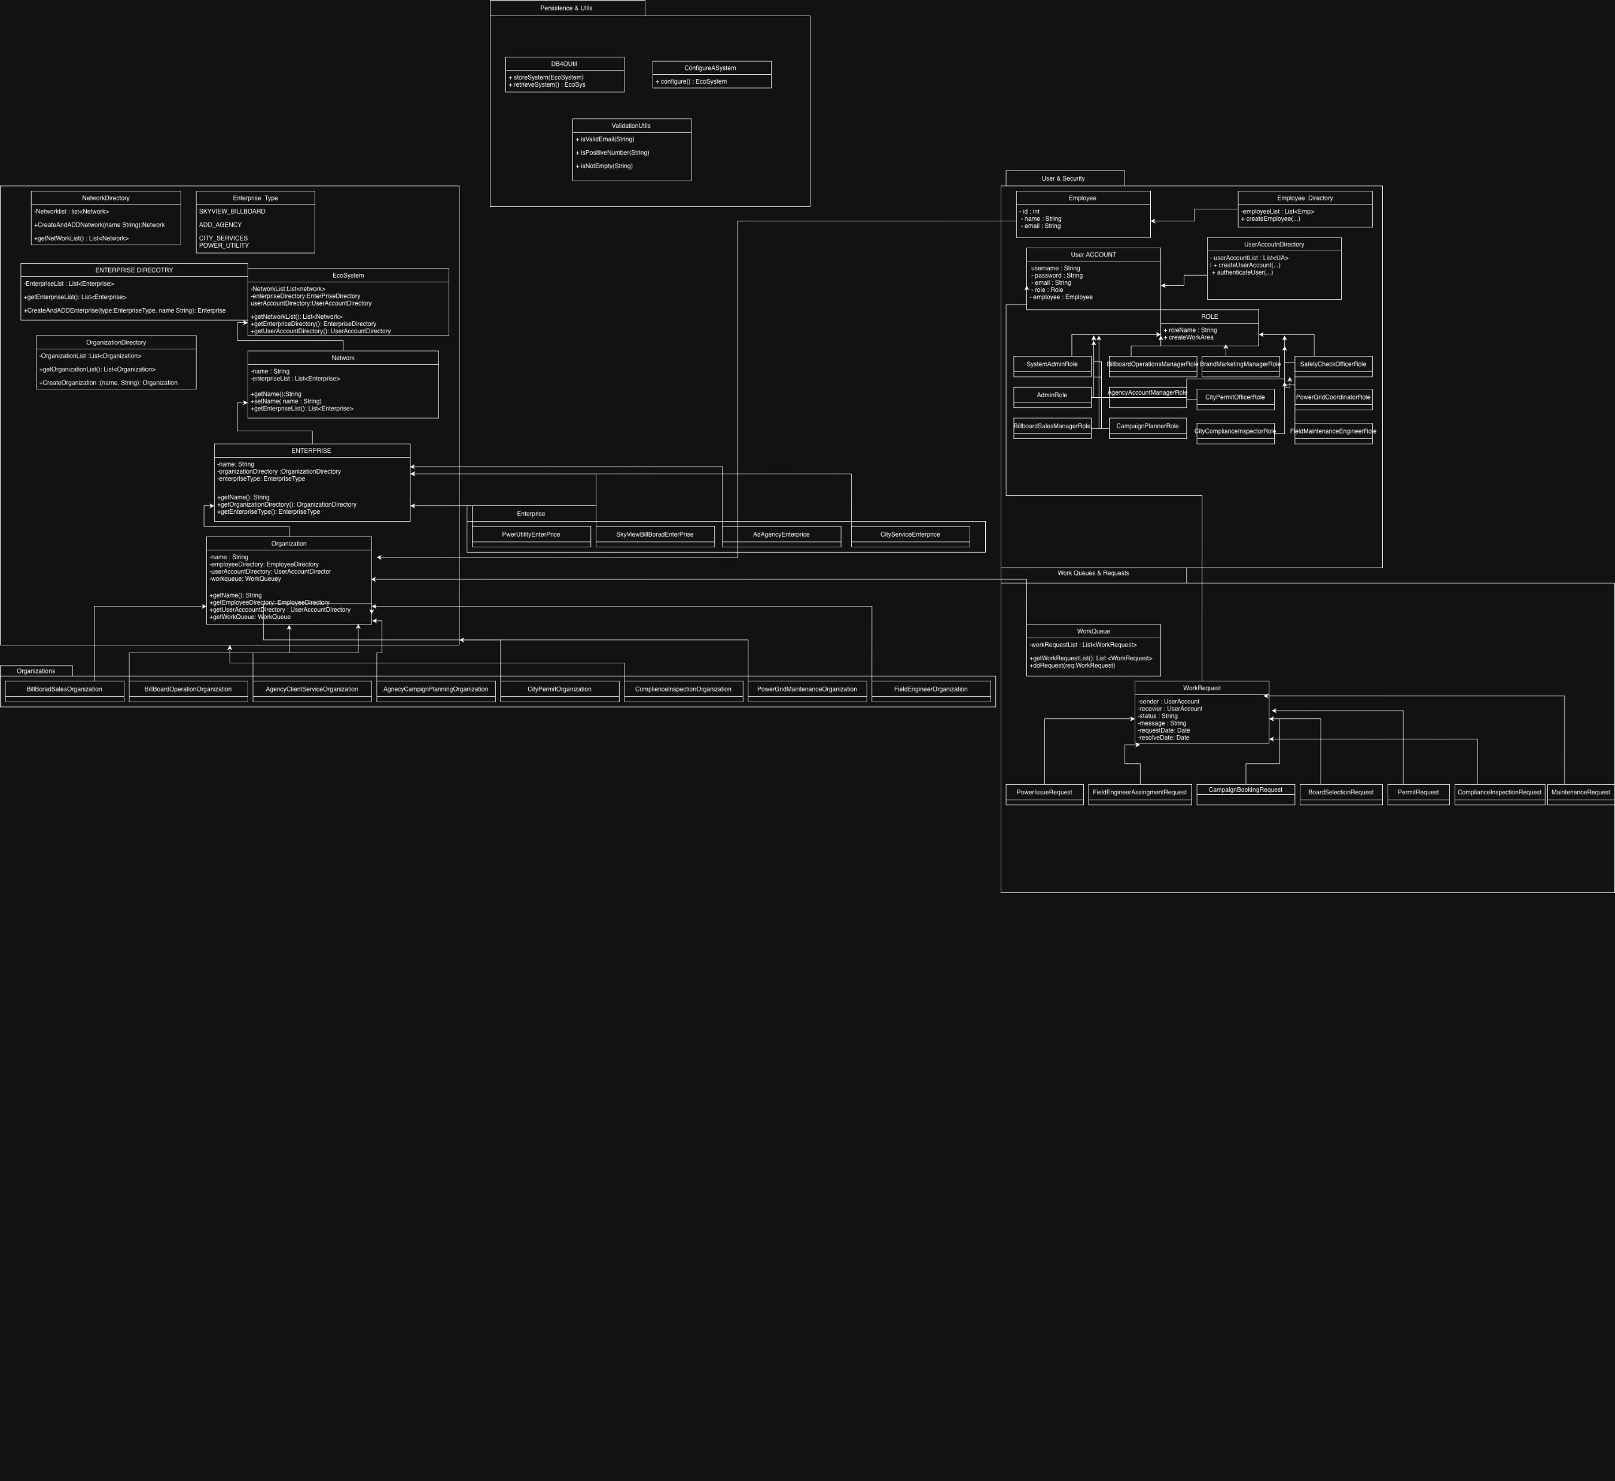
High-Level Component Diagram

Slide 5
User Roles & Login Types
Admin Roles
SystemAdminRole
Enterprise Admins (per enterprise)
Business Roles (10)
Billboard:
  BillboardSalesManagerRole
  BillboardOperationsManagerRole
Agency:
  AgencyAccountManagerRole
  CampaignPlannerRole
  BrandMarketingManagerRole
City Services:
  CityPermitOfficerRole
  CityComplianceInspectorRole
Power Utility:
  PowerGridCoordinatorRole
  FieldMaintenanceEngineerRole
  SafetyCheckOfficerRole

Slide 6
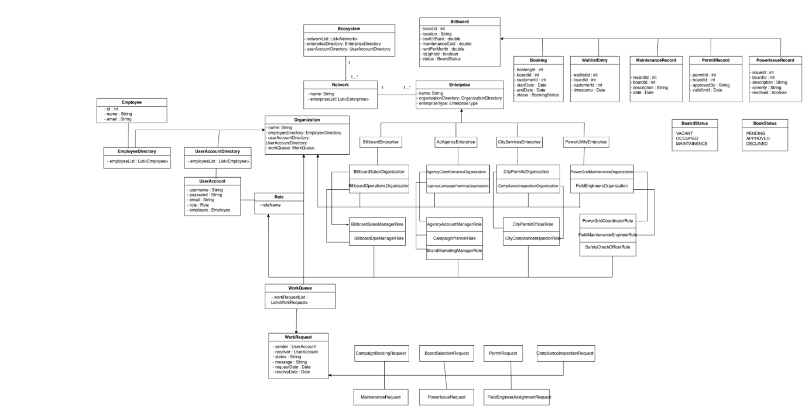
UML Class Diagram

Slide 7
WorkRequest Architecture
Abstract Class
WorkRequest
sender
receiver
status
requestDate
message
Implemented Requests
CampaignBookingRequest
BoardSelectionRequest
PermitRequest
ComplianceInspectionRequest
MaintenanceRequest
PowerIssueRequest
FieldEngineerAssignmentRequest

Slide 8
Workflow Example: Campaign Booking
End-to-End Flow
Brand Marketing Manager requests a campaign
Agency Account Manager submits CampaignBookingRequest
Billboard Sales Manager reviews availability
If approved → PermitRequest sent to City Services
City Permit Officer approves → campaign activated
Enterprises Involved
Ad Agency → Billboard → City Services

Slide 9
Workflow Example: Power & Maintenance
End-to-End Flow
Billboard Operations Manager detects issue
Creates PowerIssueRequest
Power Grid Coordinator assigns engineer
Field Engineer resolves issue
Status updated across the ecosystem
Enterprises Involved
Billboard → Power Utility

Slide 10
Advanced Features, Demo & Conclusion
Advanced Features
Billboard waitlisting (WaitlistEntry)
Maintenance tracking (MaintenanceRecord)
Compliance inspections
Role-based dashboards
Validations (ValidationUtils)
Persistent storage (DB4O)
Demo Plan
System Admin setup
User creation
Campaign booking flow
Power issue resolution flow
Conclusion
A scalable, real-world, multi-enterprise system aligned with INFO 5100 requirements.

